Slide 1
GEOG 392/676 GIS Programing Lab7
Zhenlei Song, Ph.D Student
Department of Geography
Email: songzl@tamu.edu
Office: CSA 301F

Slide 2
Lab 6 Tasks
Download datasets
Digital Elevation Model (DEM) – single band
Satellite Imagery (multispectrum) – multi band
Use DEM to
create hillshade & slope raster images
Use satellite imagery to
create a RGB composite raster image
create a Esri-NDVI raster image

Slide 3
Data Sources
Data Source
Digital Elevation Model (DEM) – single band
Link: https://github.com/TAMUCIDI/GEOG-392-GIS-Programming/blob/main/Labs/Lab07/Data/DEM/n30_w097_1arc_v3.tif
Satellite Imagery (LandSAT) – multi band
Link: https://github.com/TAMUCIDI/GEOG-392-GIS-Programming/tree/main/Labs/Lab07/Data/LandSAT

Slide 4
Important Notes
Read this material carefully and follow the steps:
Link: https://github.com/TAMUCIDI/GEOG-392-GIS-Programming/blob/main/Labs/Lab07/Lab07.md
DON’T upload the data files to your Github repo unless you set up “large file storage” (LFS) for your repo correctly.
There is NO code template for this lab.

Slide 5
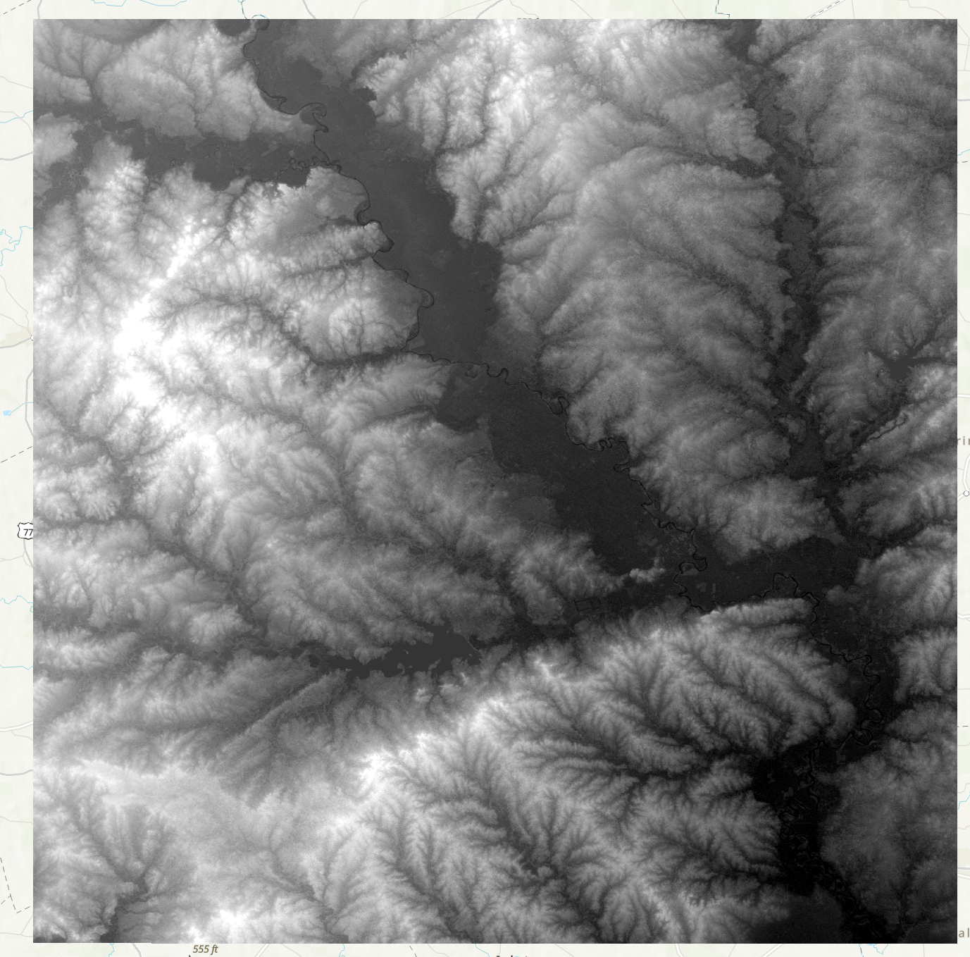
Part 1. DEM Source Data
DEM raster for College Station/Bryan area
The higher value is, the lighter the color is.

Slide 6
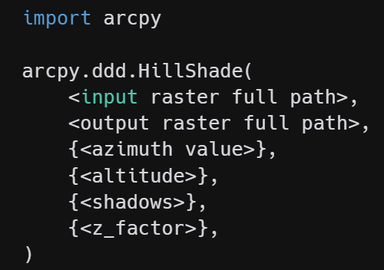
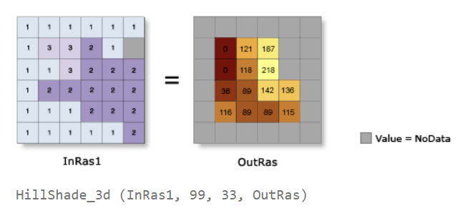
Part 1-1. Hill Shade
Hill Shade Algo
API Doc: https://pro.arcgis.com/en/pro-app/latest/help/analysis/raster-functions/hillshade-function.htm
Alternative API: `arcpy.sa.HillShade()`
Notes:
replace this with your `DEM` tif file path.
replace this with your output tif file path.
The azimuth of the sunlights. It’s optional, you can use the default value as 315.
Altitude of sunlight, optional, use the default value of 45.
NO_SHADOWS
1
All params with brackets {} are optional.
There is an optional API, but the params are different. Look carefully which one you are using.

Slide 7
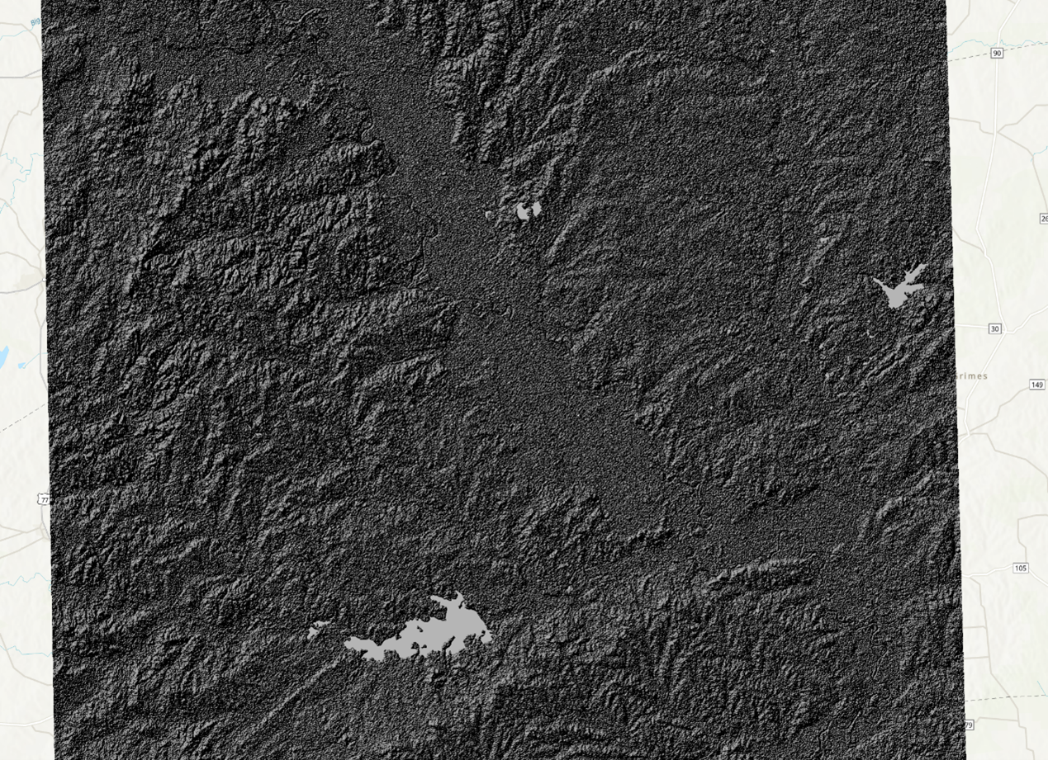
Part 1-1. Hill Shade
Hill Shade Result

Slide 8
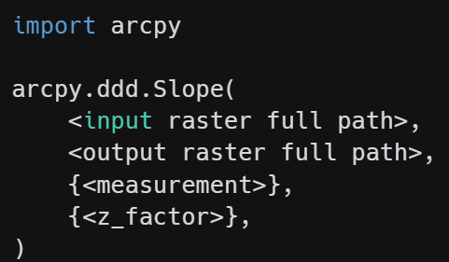
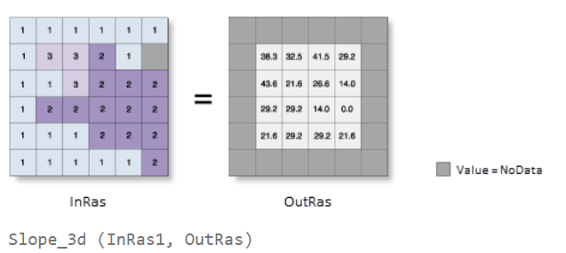
Part 1-2. Slopes
Slope Algo
API Doc: https://pro.arcgis.com/en/pro-app/latest/help/analysis/raster-functions/slope-function.htm
Alternative API: `arcpy.sa.Slope()`
Notes:
replace this with your `DEM` tif file path.
replace this with your output tif file path.
The measurement is either “DEGREE” or “PERCENT_RISE”
Z_factor as 1

Slide 9
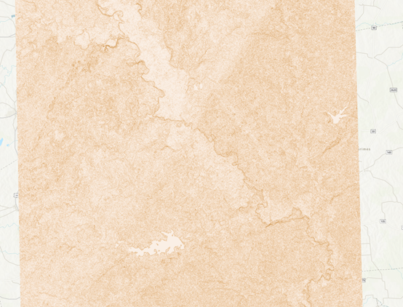
Part 1-2. Slope
Slope Result

Slide 10
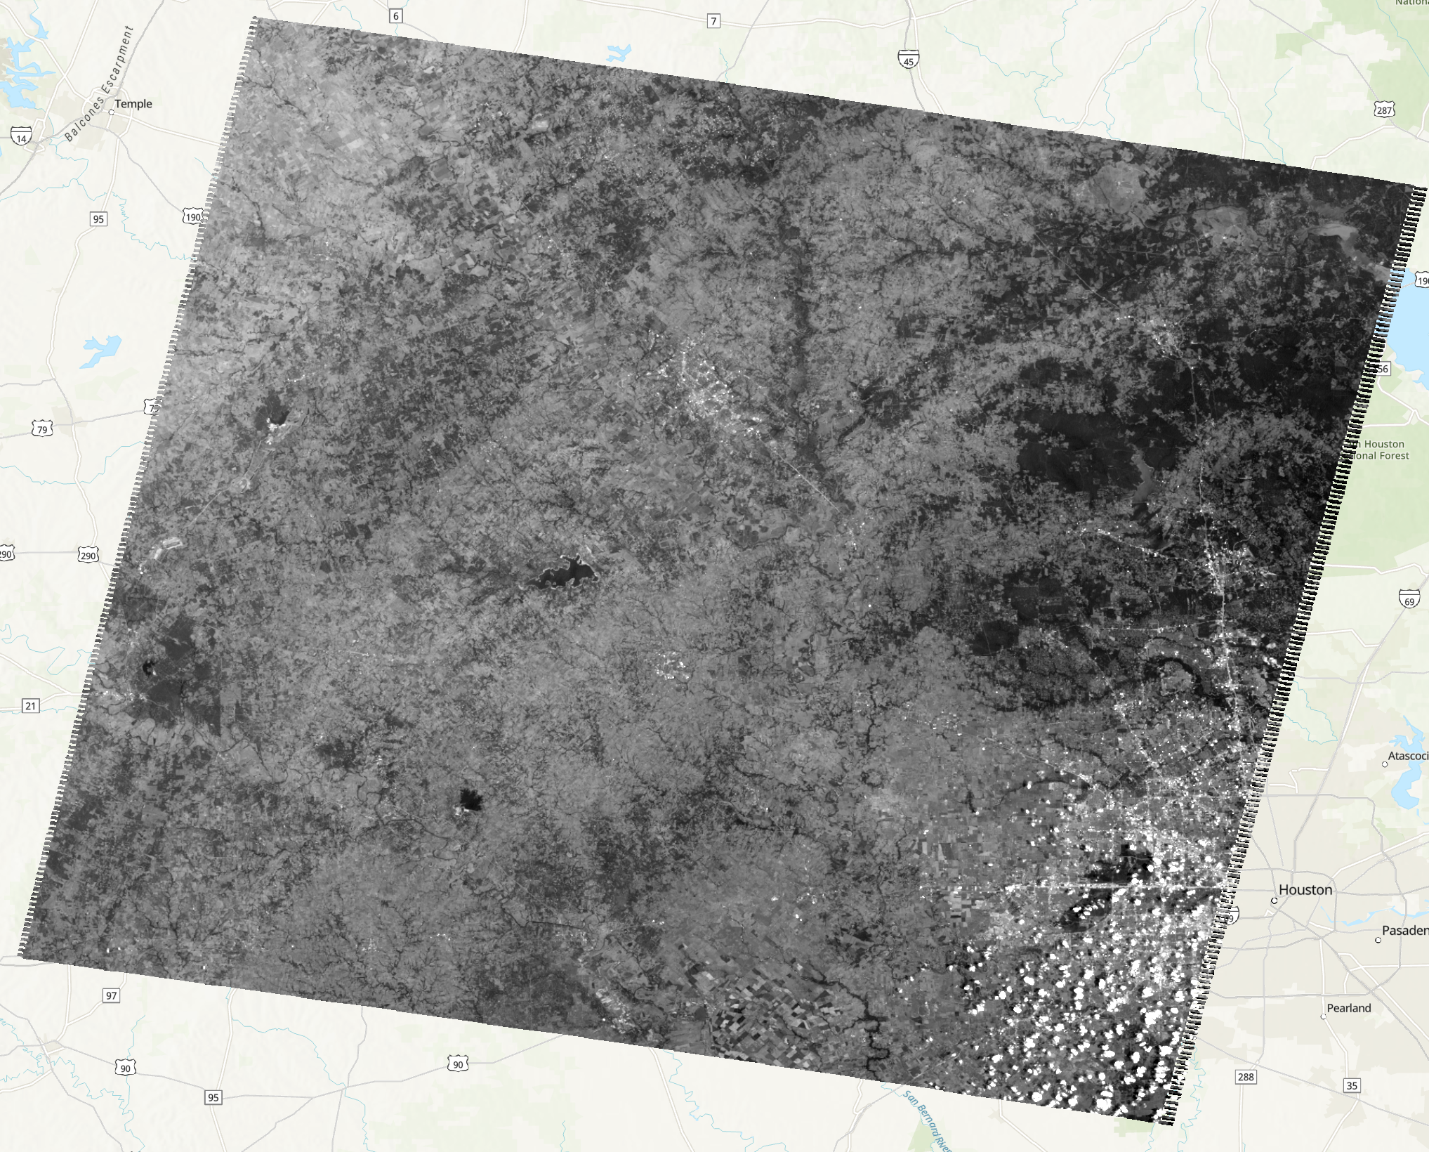
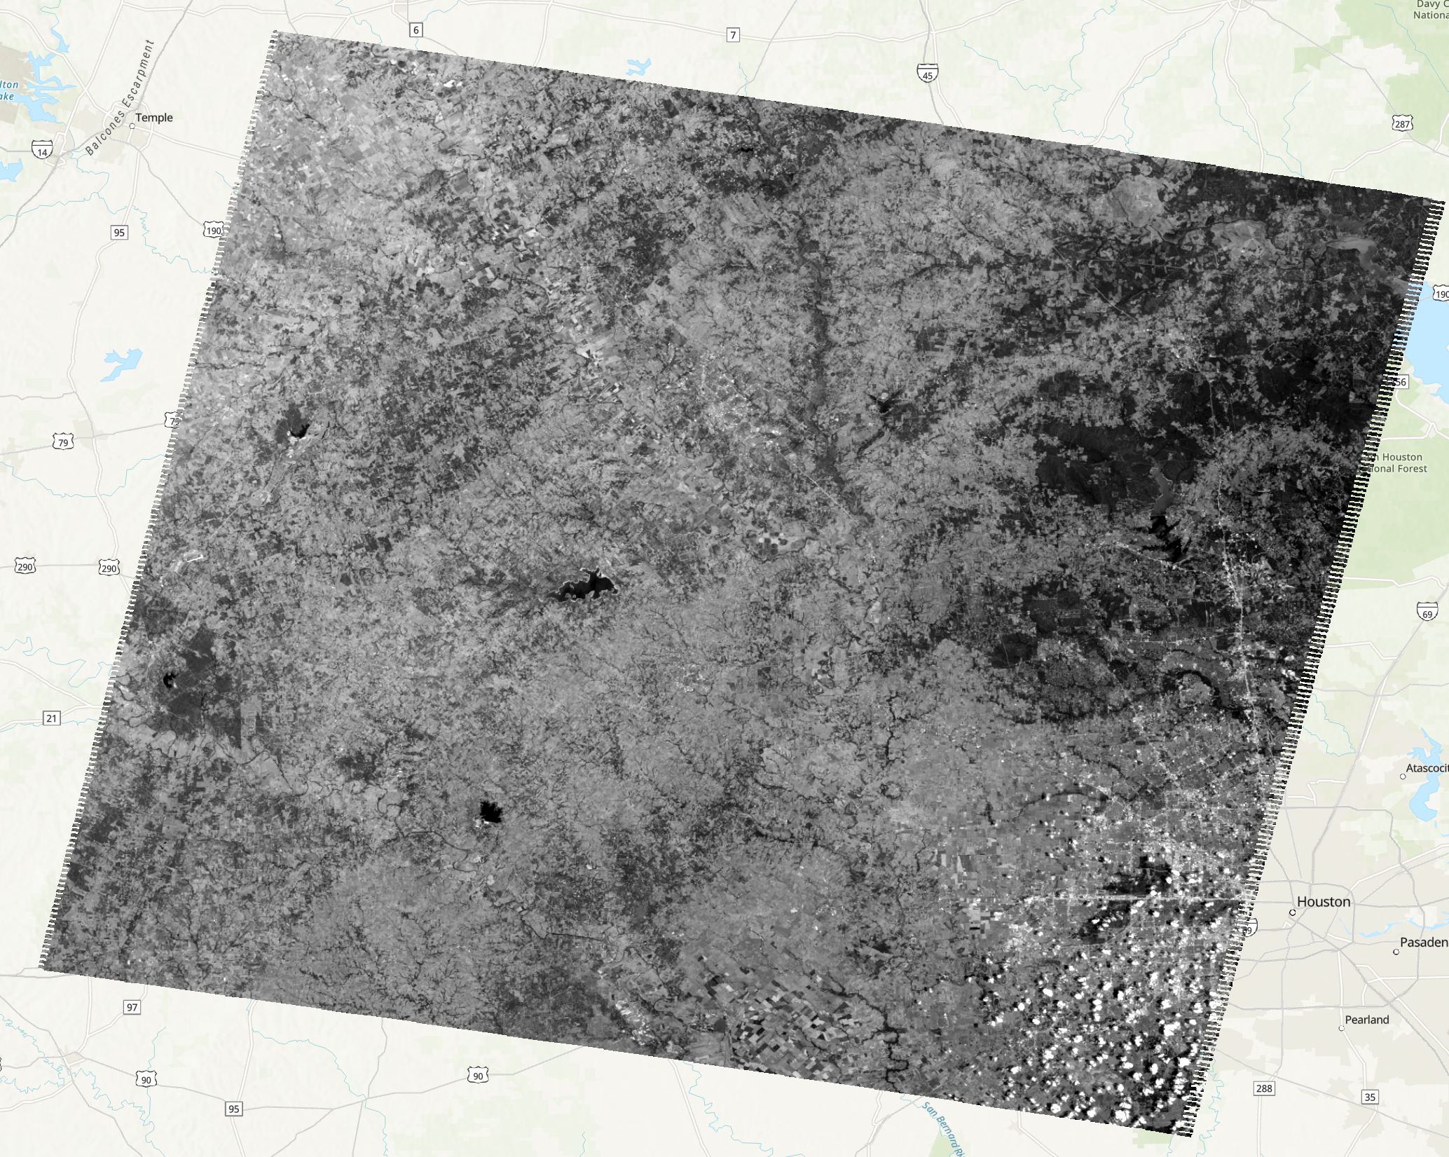
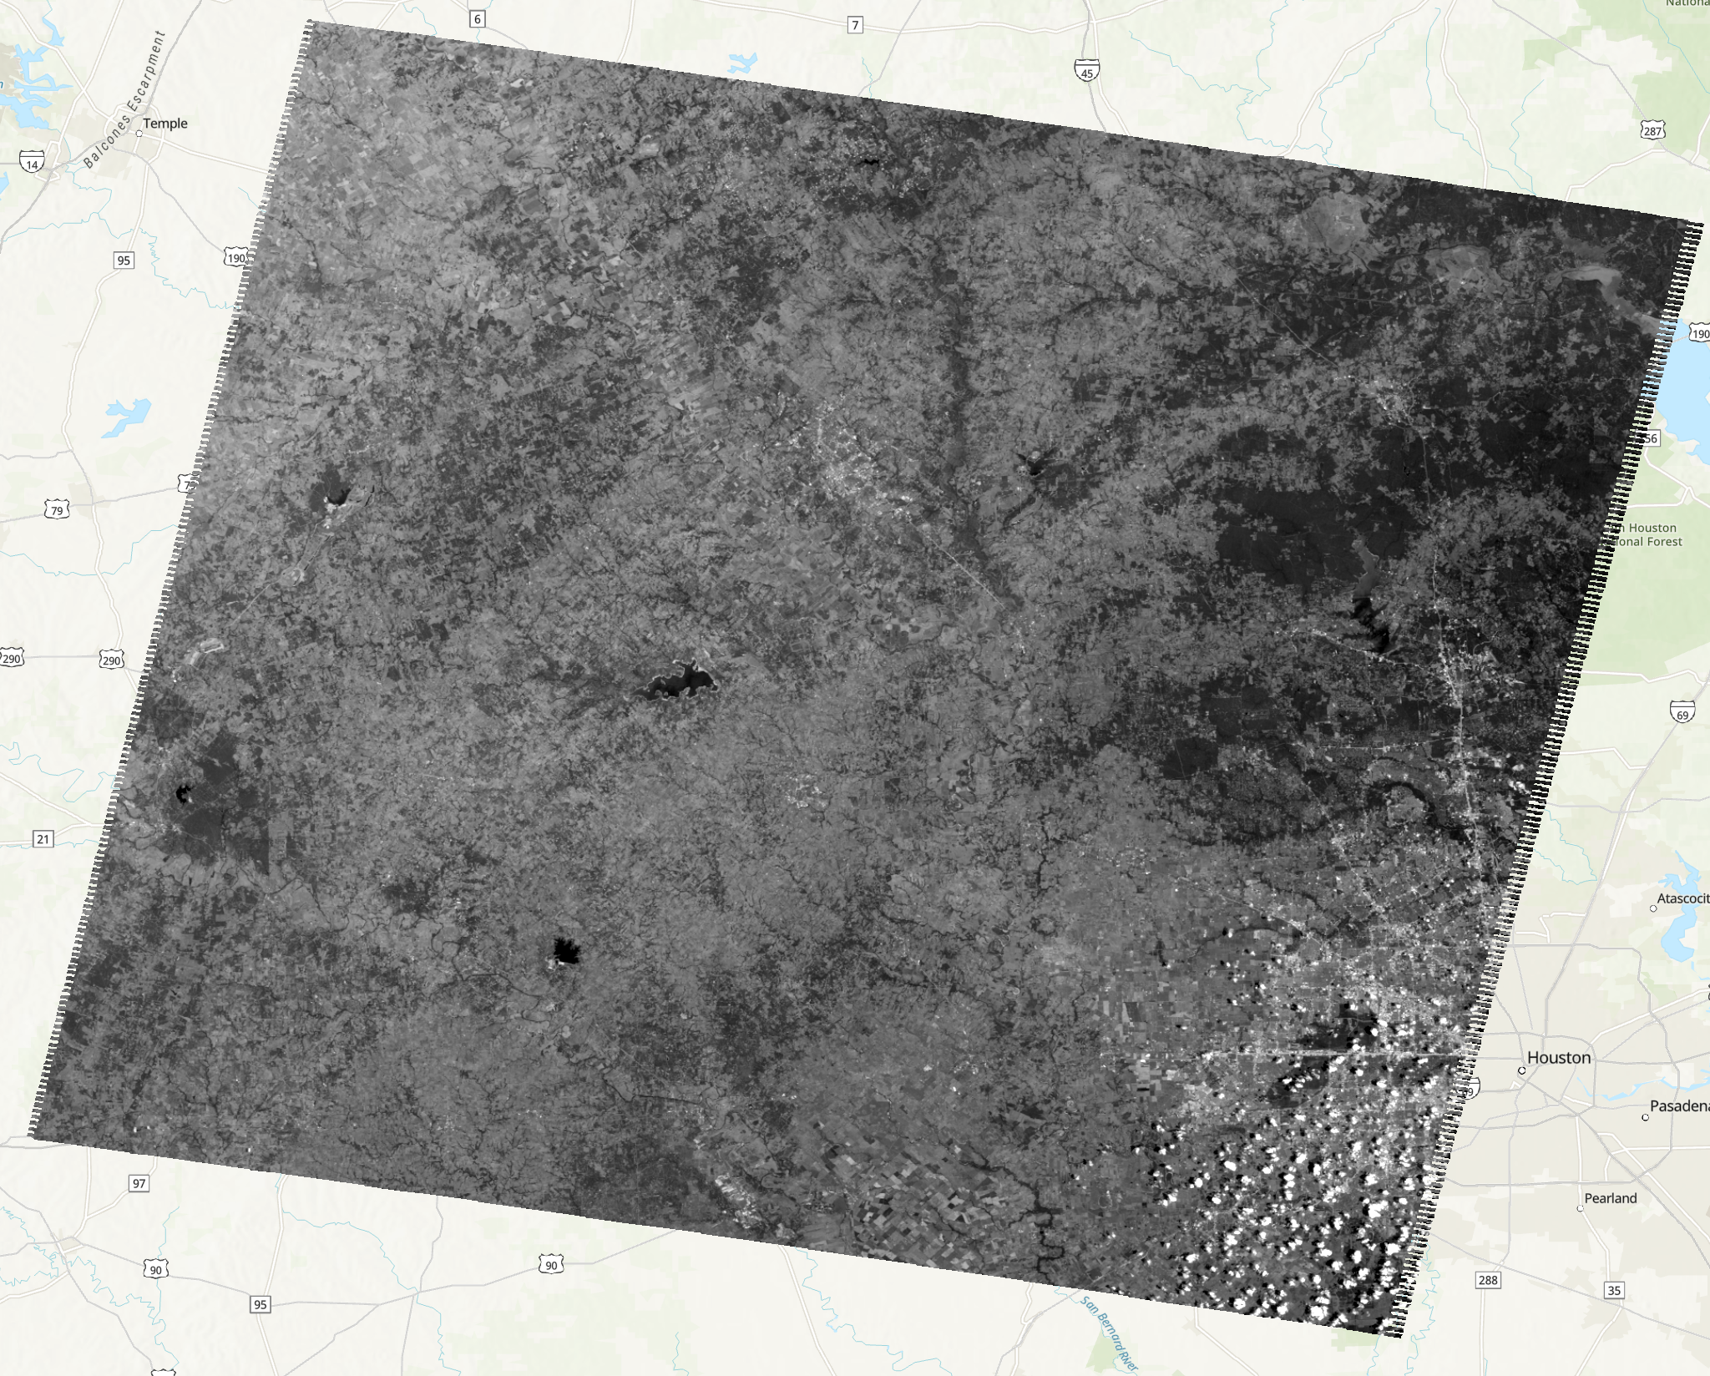
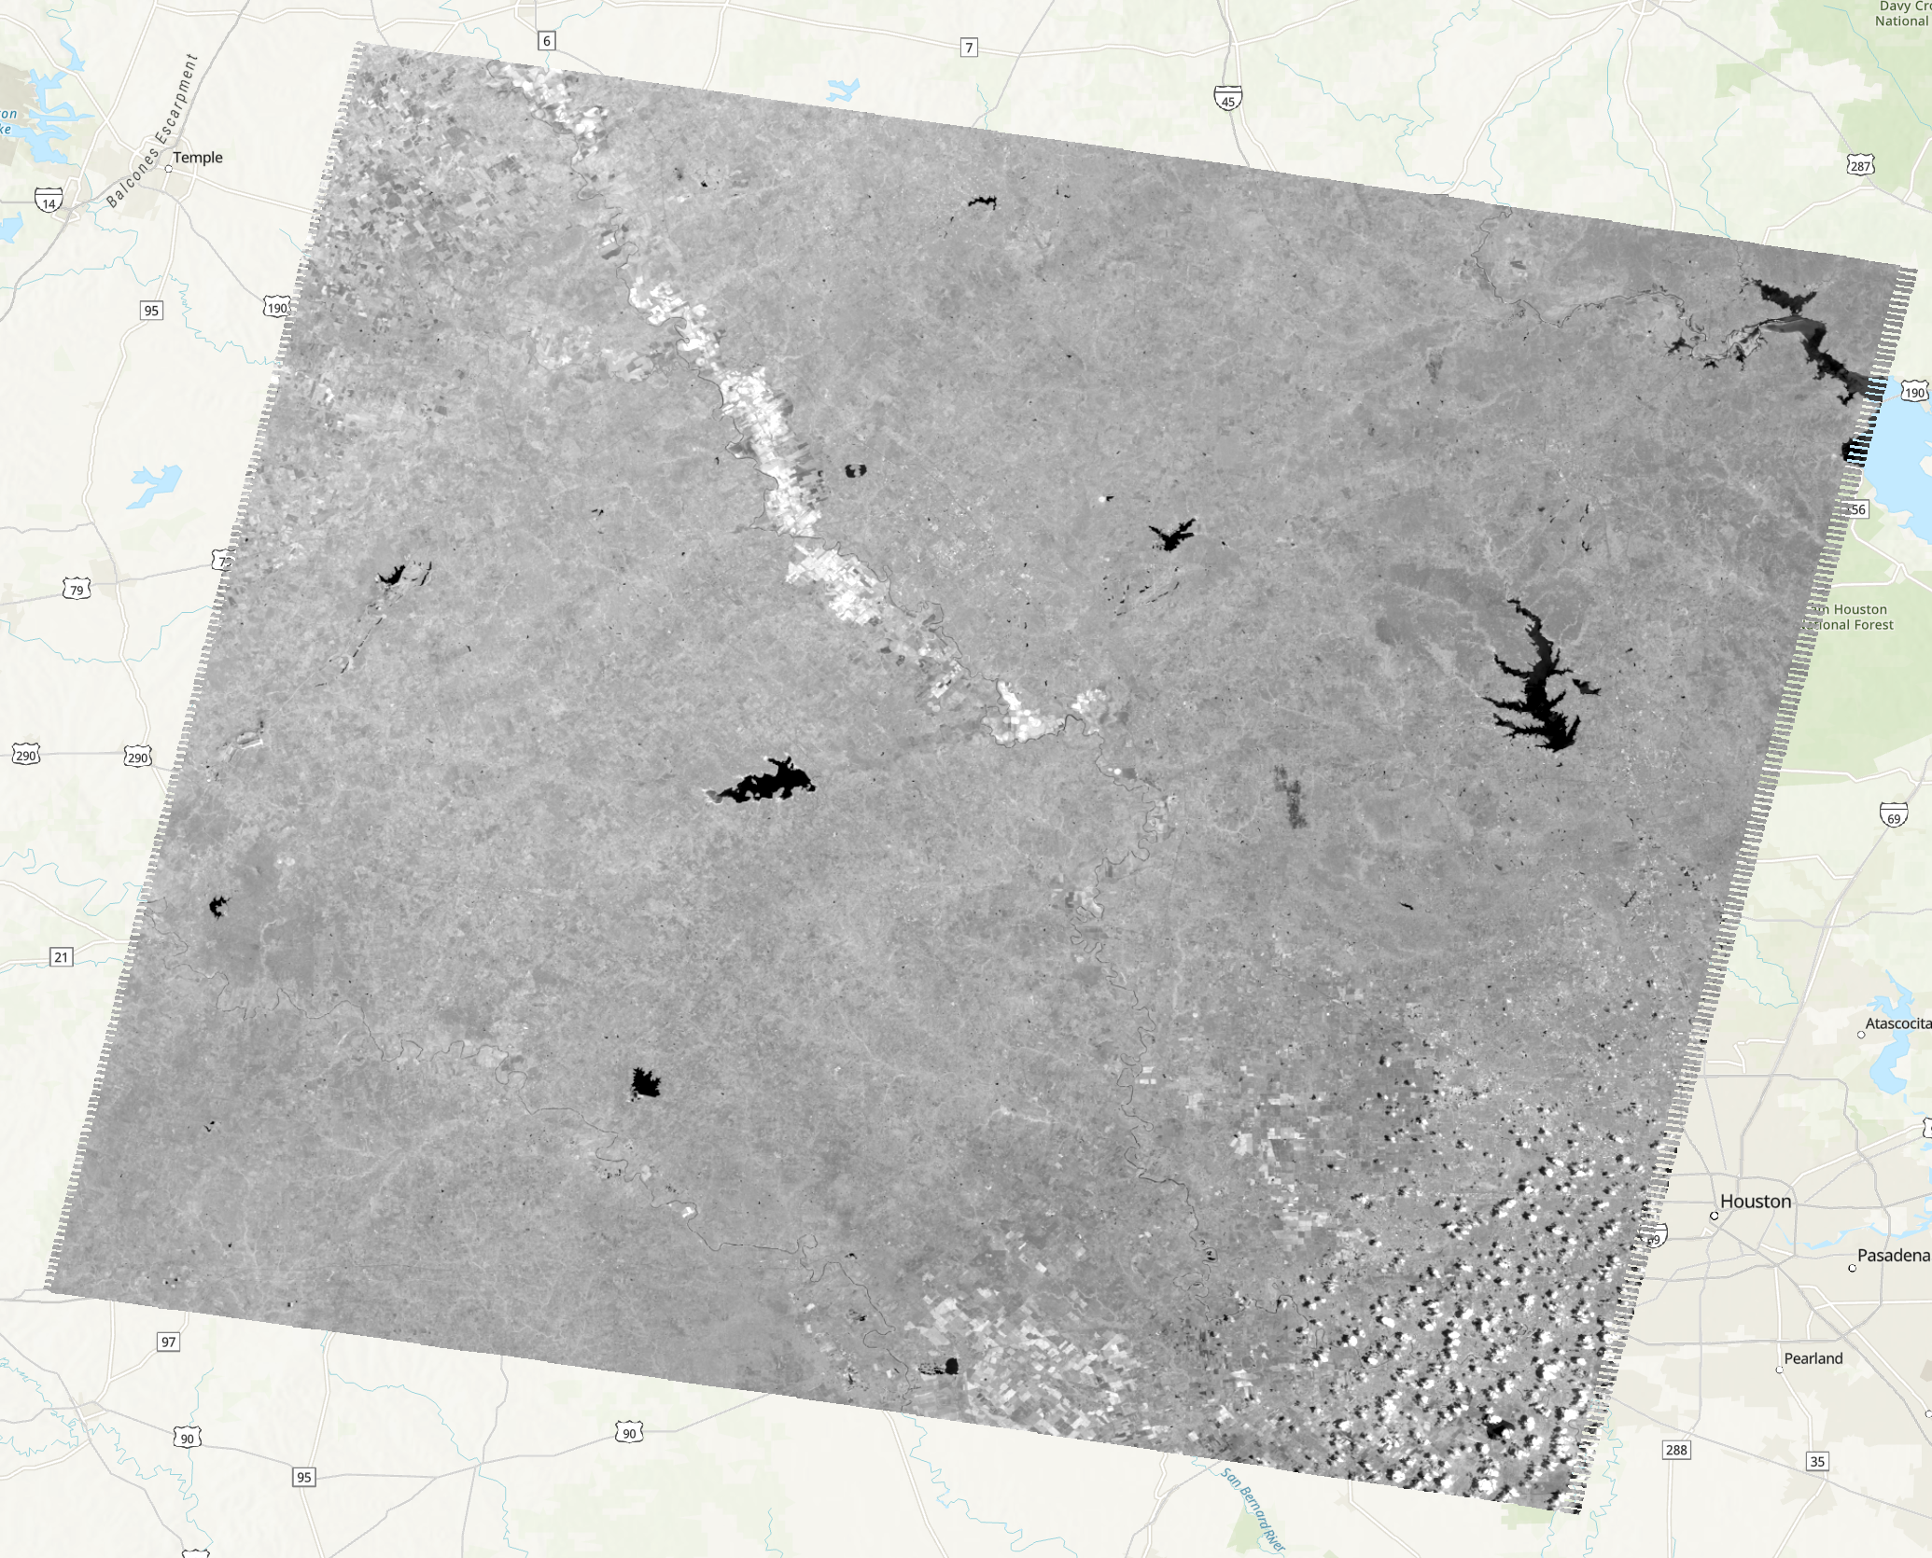
Part 2. LandSAT Source Data
Band1. Blue
Band3. Red
Band2. Green
Band4. Infra-Red

Slide 11
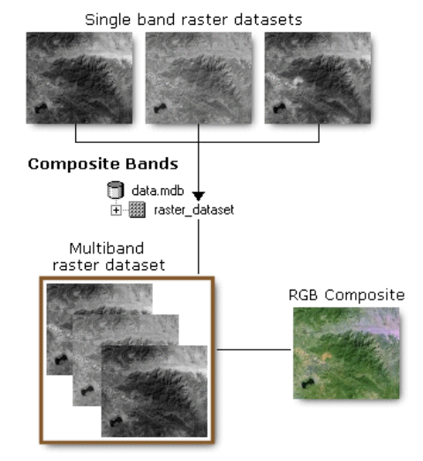
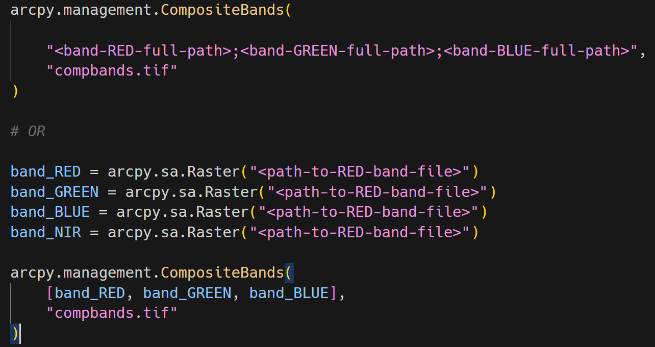
Part 2-1. Composite Image
Composite Imagery Algo
Raster: https://pro.arcgis.com/en/pro-app/latest/arcpy/classes/raster-object.htm
Composite Bands: https://pro.arcgis.com/en/pro-app/latest/tool-reference/data-management/composite-bands.htm
Notes:
Please please please be careful with the band order.
What we want is a RGB composite image, so make the band order as R – G – B .

Slide 12
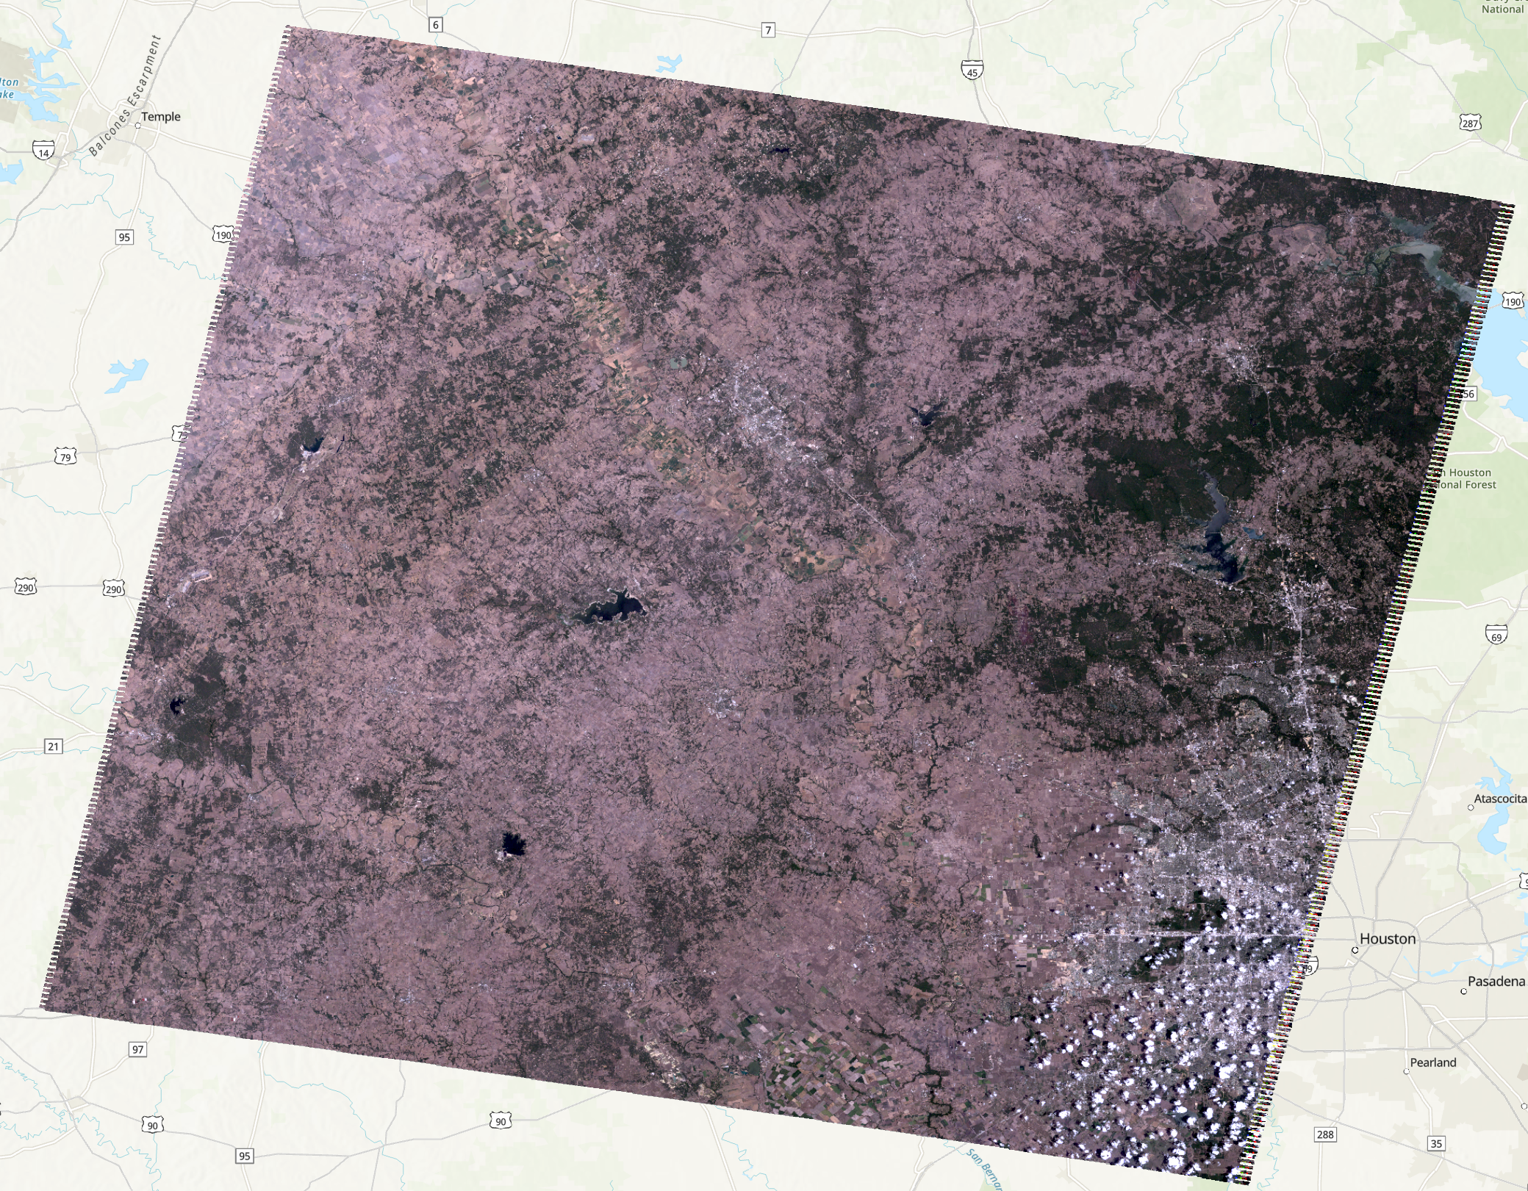
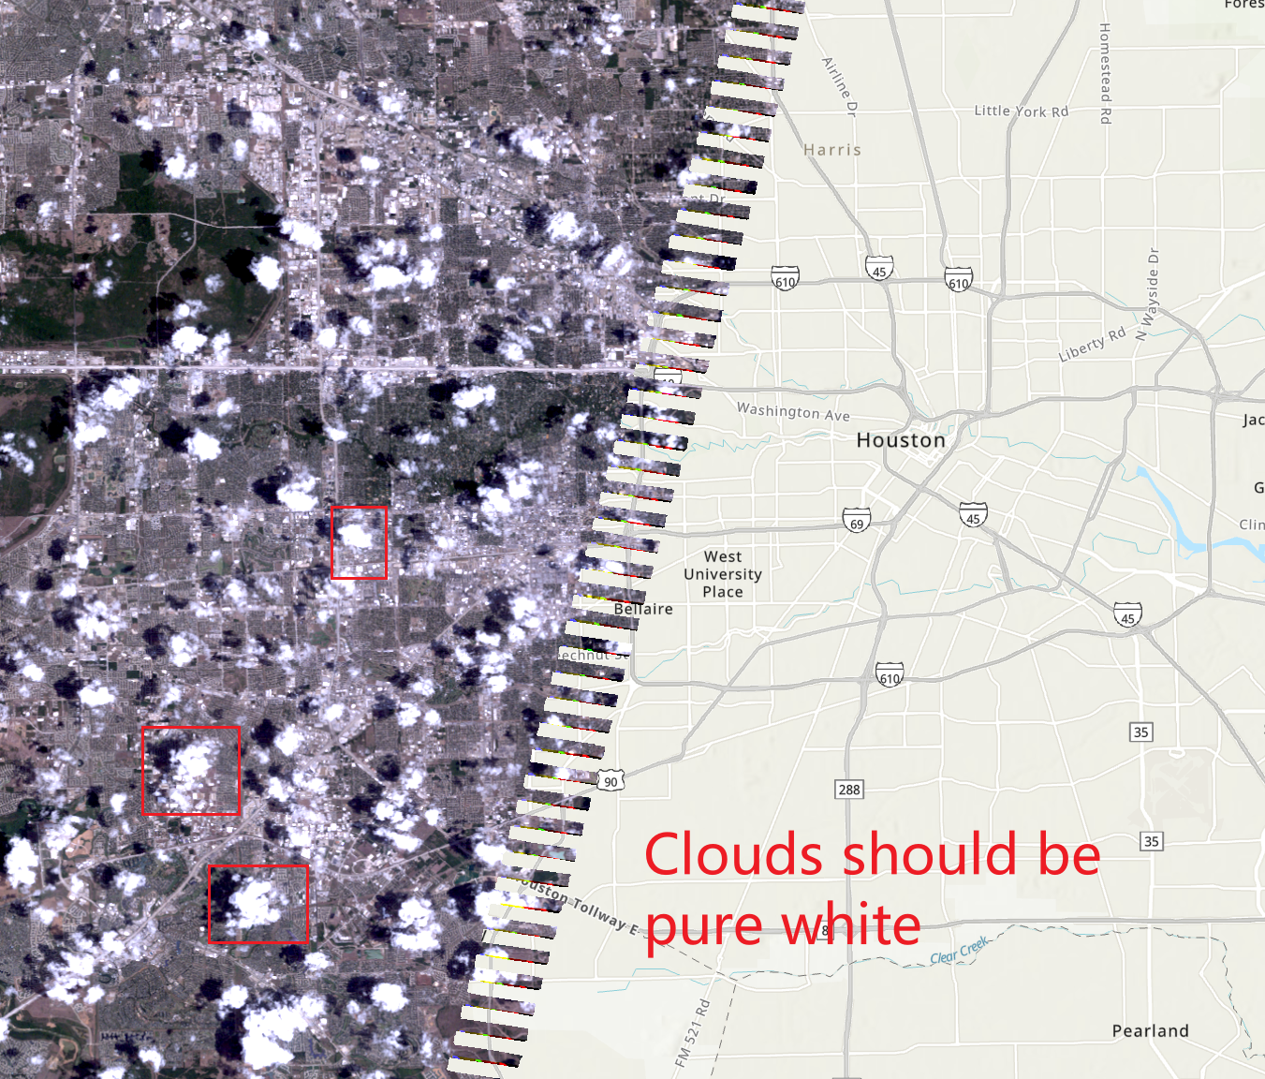
Part 2-1. Composite Image
Composite Imagery Result
Notes:
If you set everything correctly, you should see the composite layer as the figures here.
If you mess up with the band order, you would probably see different color schemes.
To tell if it’s right yourself, zoom into the west of Houston, there are some clouds there.
If your result is right, the clouds should be pure white.

Slide 13
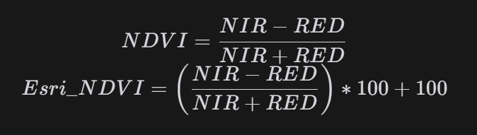
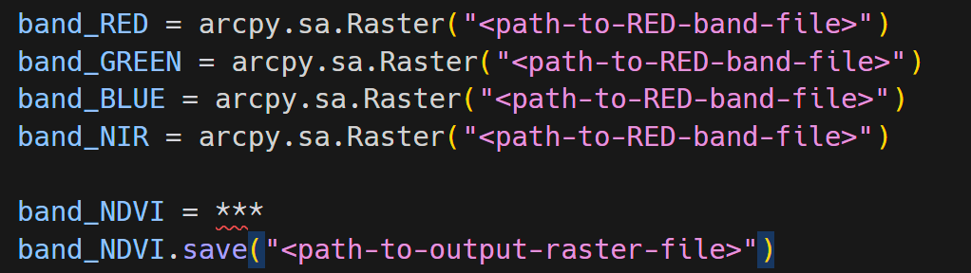
Part 2-2. NDVI
Esri NDVI Algo

Slide 14
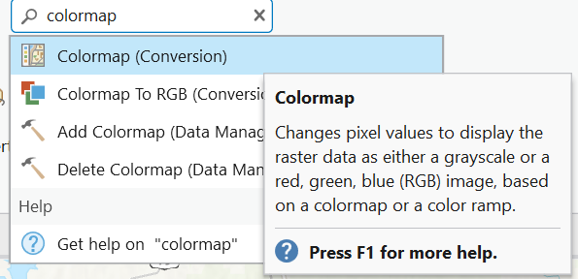
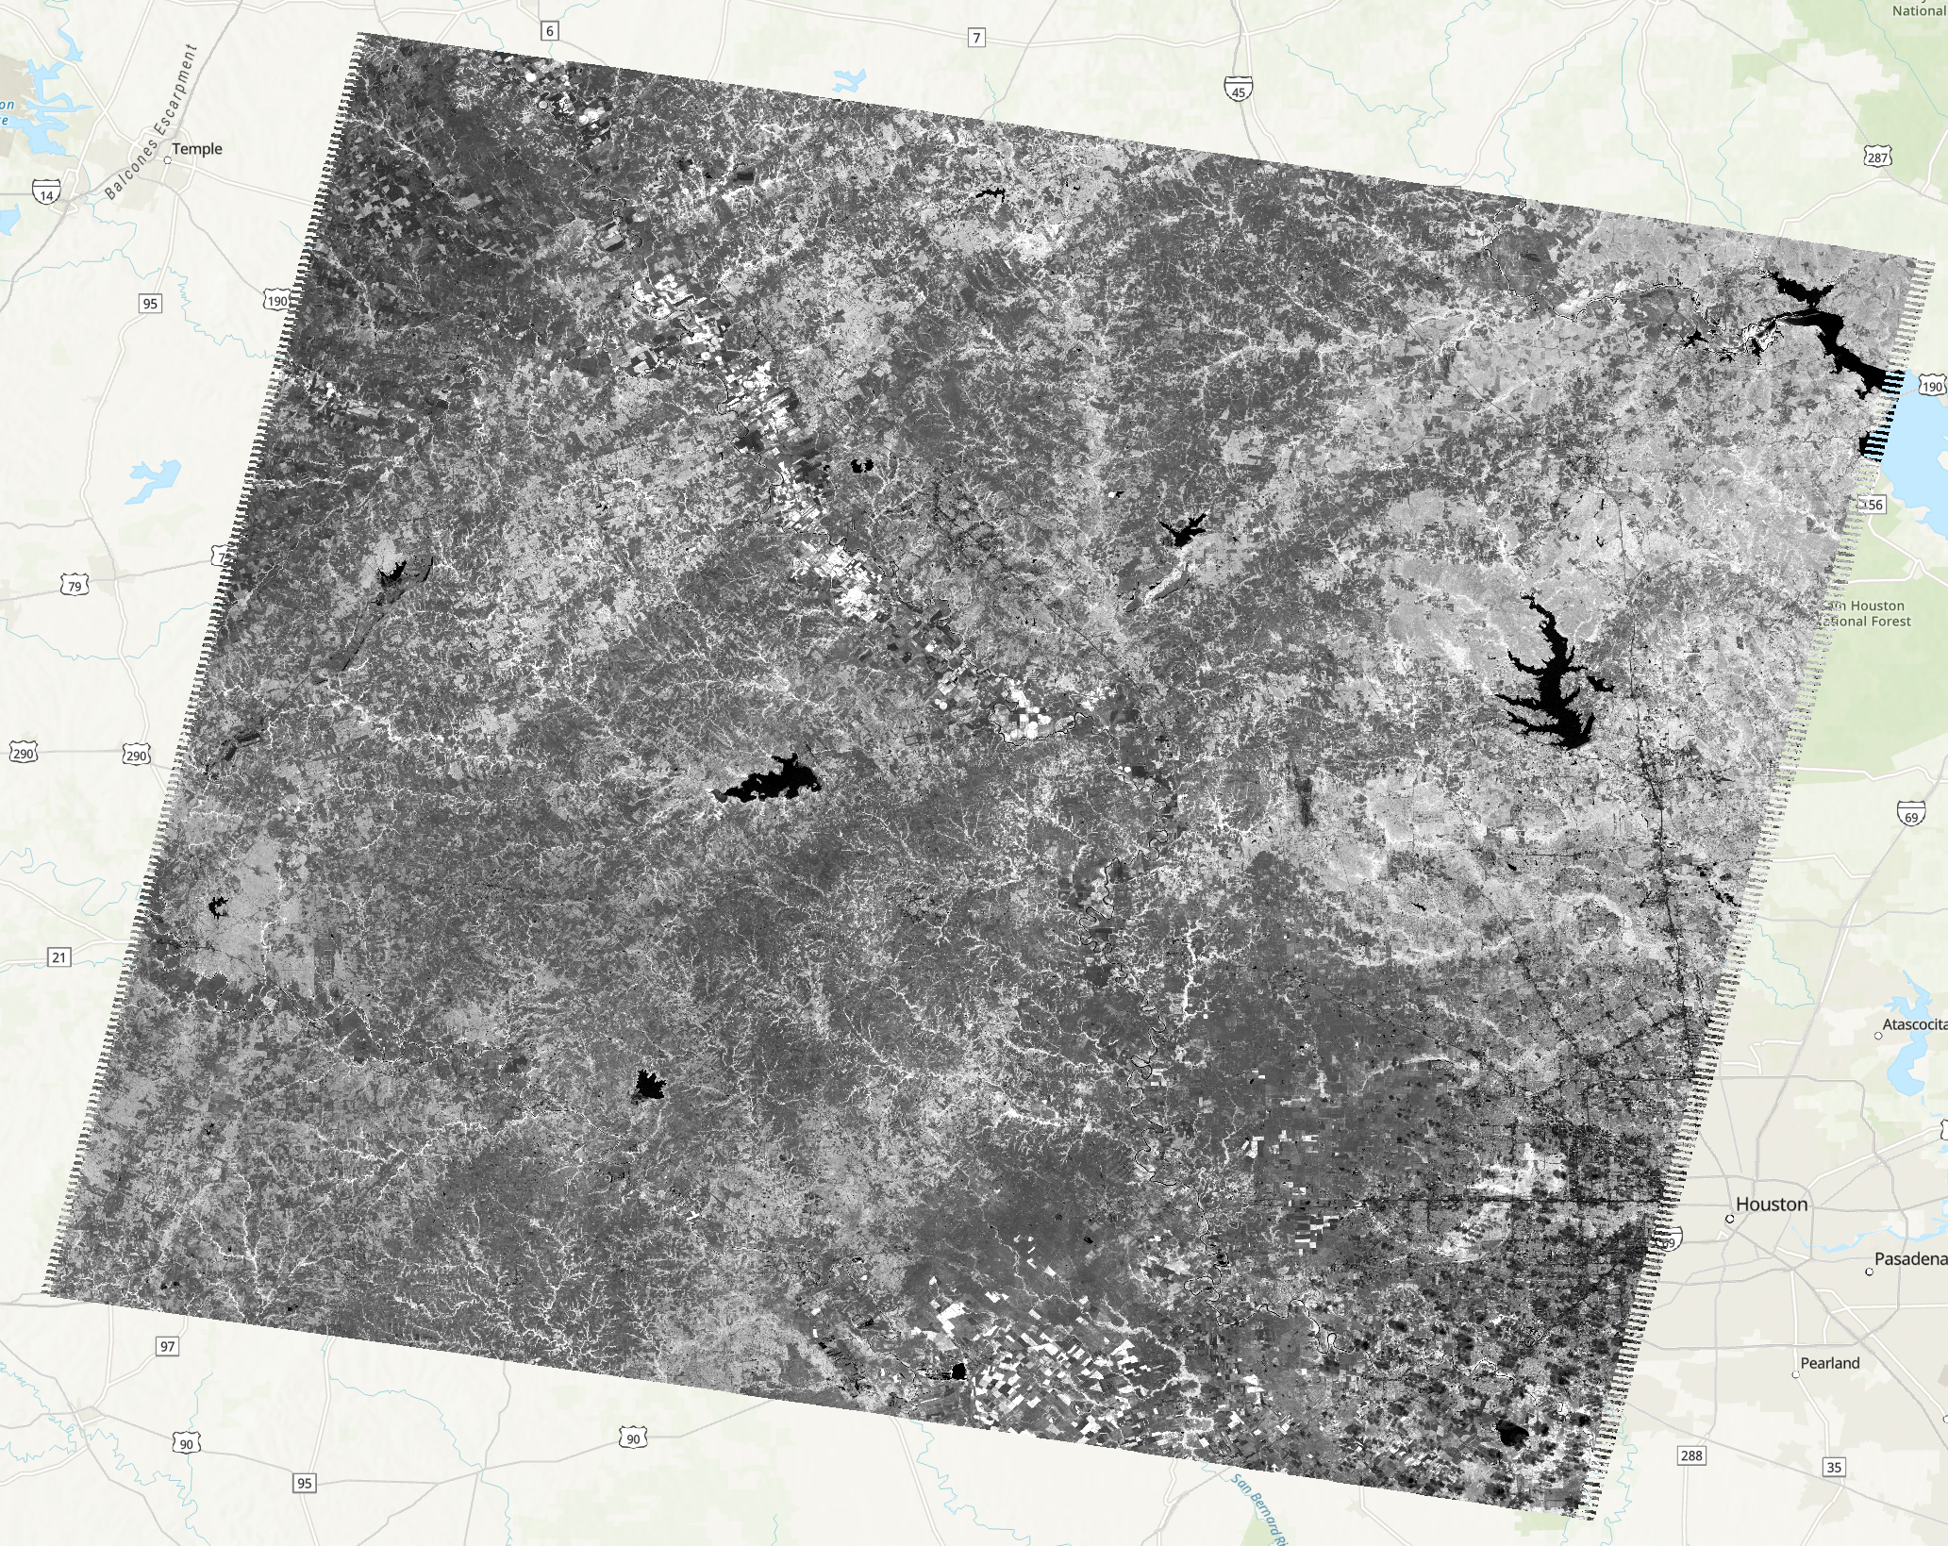
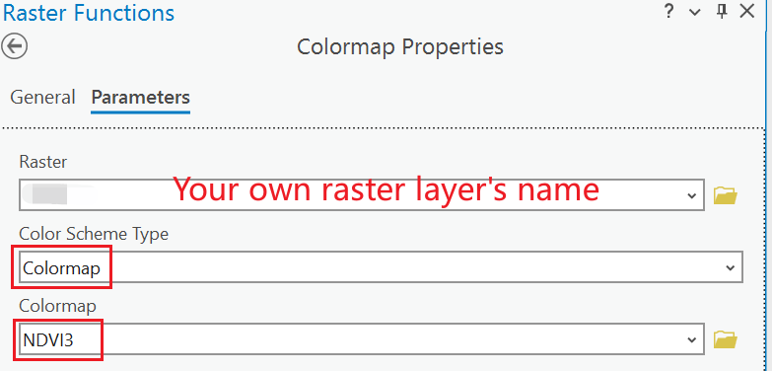
Part 2-2. NDVI
NDVI Raster Result

Slide 15
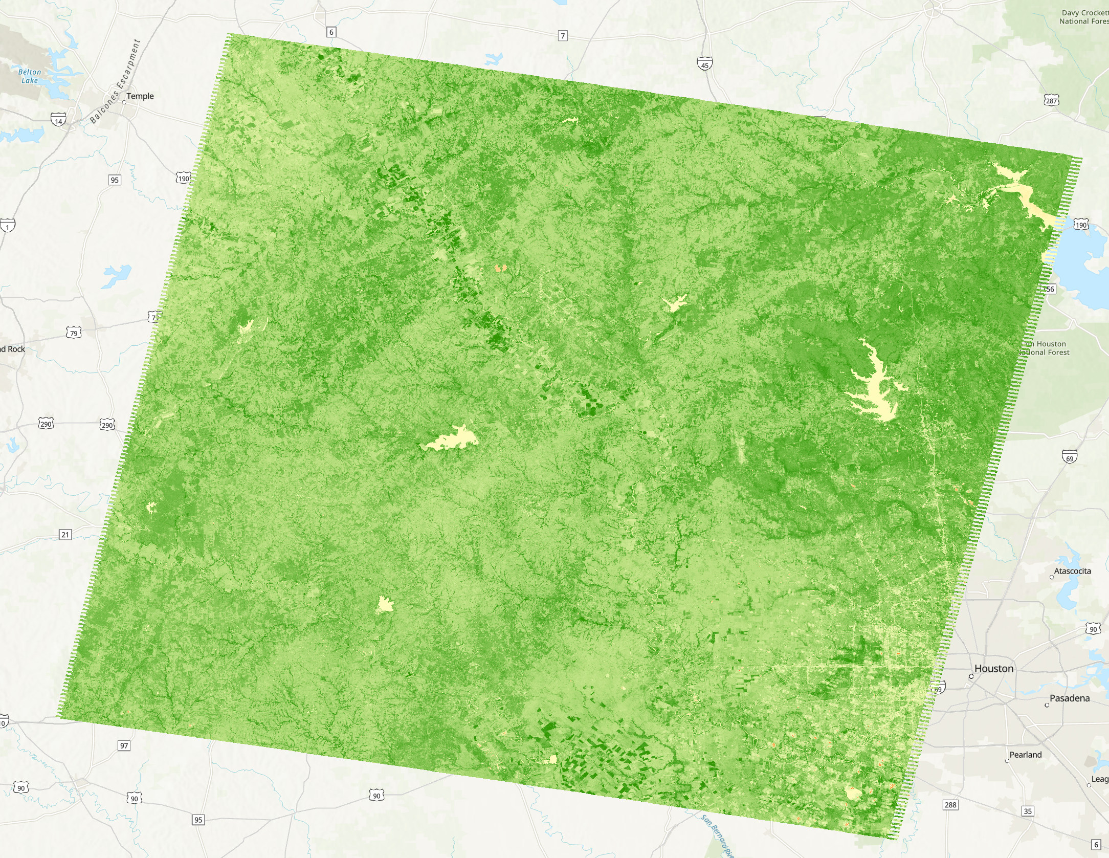
Part 2-2. NDVI
NDVI Raster Result

Slide 16
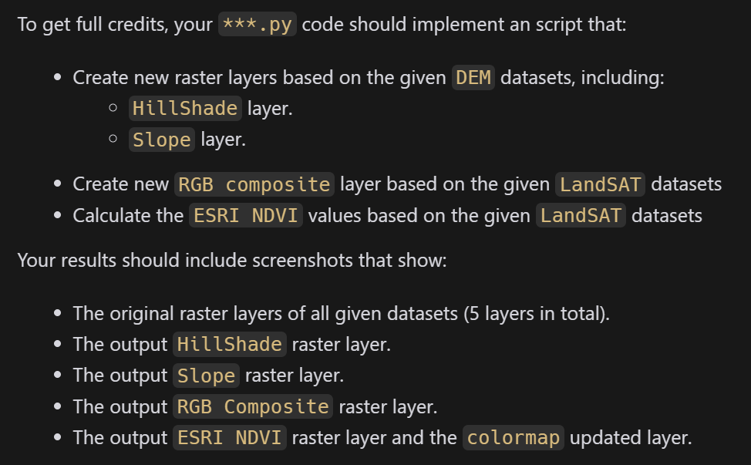
Submission
A PDF file includes:

Slide 17
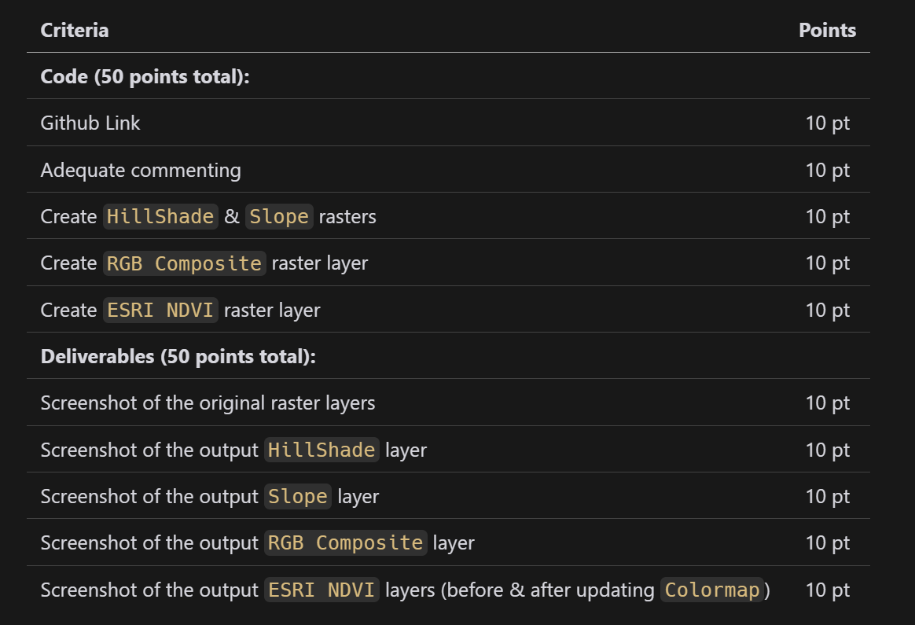
Grading Rule

Slide 18
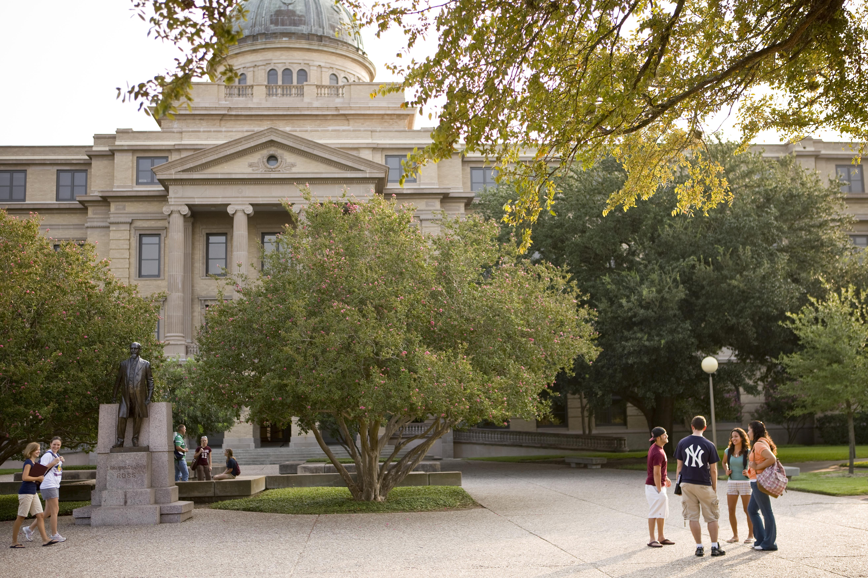
Additional Resources
Useful Links
HillShade
Slope
Raster
CompositeBands
VS Code Plugins
Python
Pylance
Python Debugger
Gitlens

Slide 19
The End

